Slide 1
Data Explorin’ the World
Rachel Roggenkemper and Lana Huynh
Notes:
R: Ladies and gentlemen, welcome onboard. This is your captains, Rachel and Lana, speaking with some information about your flight. We are currently first in line for take-off and are expected to be in the air for approximately seven minutes with time for questions at the end. We ask that you please fasten your seatbelts at this time and secure all baggage underneath your seat.
L: We also ask that your seats are in the upright position for take-off. Please turn off all personal electronic devices, including laptops and cell phones. Smoking is prohibited for the duration of the flight. Thank you for choosing Dynamic Duo Airlines. Enjoy your flight.

Slide 2
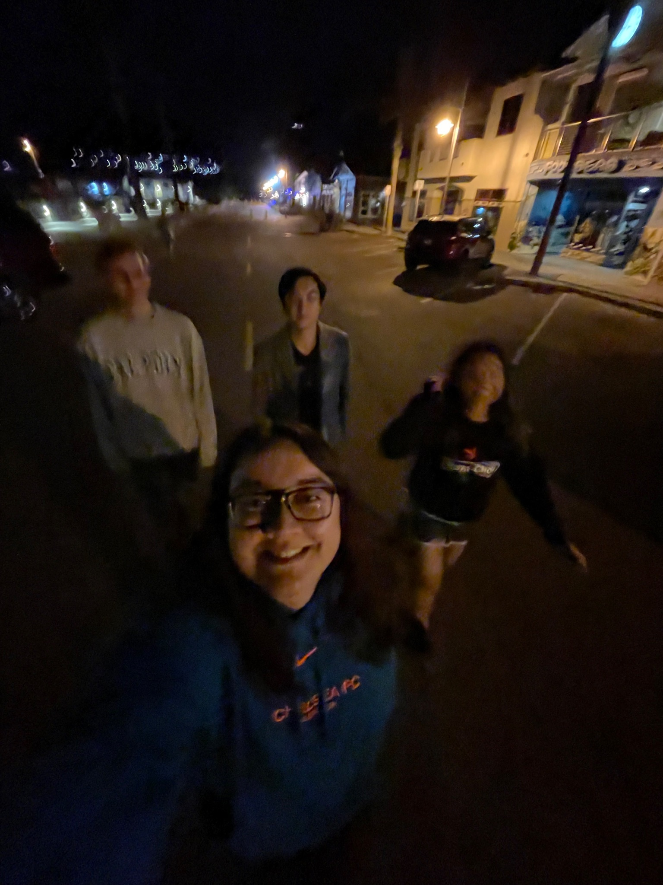
Research Questions and Motivation
Motivation:
Both of us are enthusiastic travelers and are thrilled to be looking into more travel related data
Research Questions:
What does tourism look like on an international level?
What does flying etiquette look like to different groups of people and can we predict whether or not a passenger reclines their seat on flights?

Slide 3
01
Data Collection and Cleaning

Slide 4

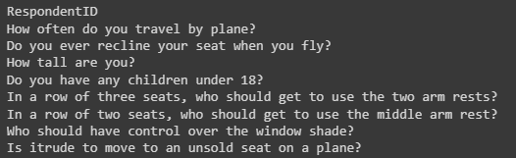
Flying Etiquette Data
SurveyMonkey Audience poll done by FiveThirtyEight
1,040 respondents, 874 of whom had flown

Slide 5
International Tourism Data
Observational unit: International tourism data for each country for each year (years ranging from 1960 to 2021) -> filtered data to focus on 1995 to 2017 to reduce NA values and to filter out projected data from Gapminder
The World Bank:
International tourism, expenditures (% of total imports)
International tourism, expenditures (current US$, inflation-adjusted)
International tourism, expenditures for passenger transport items (current US$, inflation-adjusted)
International tourism, number of arrivals
International tourism, number of departures
International tourism, receipts (current US$, inflation-adjusted)
International tourism, receipts for passenger transport items (current US$, inflation-adjusted)
International tourism, receipts for travel items (current US$, inflation-adjusted)
International tourism, receipts (% of total exports)
Gapminder:
CO2 emissions (tonnes per person)
Income per person (GDP/capita, PPP$ inflation-adjusted)
Population
Total GDP (US$, inflation-adjusted)
Country -> Continent:
Subregion and continent of each country

Slide 6
02
Data Exploration

Slide 7
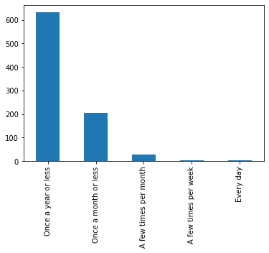
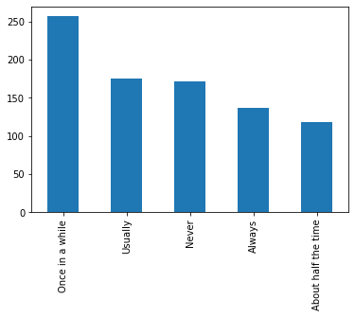
Flying Etiquette Data Overview
How often do you travel by plane?
Do you ever recline your seat when you fly?

Slide 8
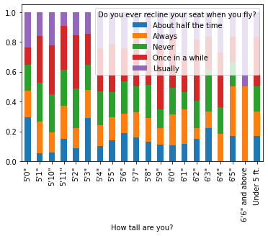
Relationship Between Height and Reclining Seat

Slide 9
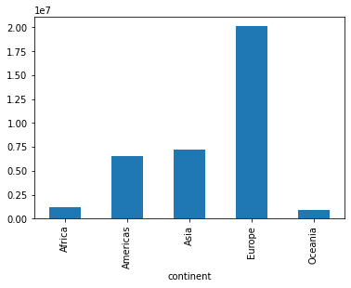
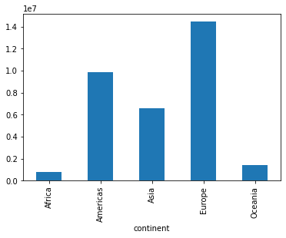
Arrivals and Departures
Number of Arrivals by Continent
Number of Departures by Continent

Slide 10

Number of Arrivals: Dot Map

Slide 11
03
Machine Learning

Slide 12
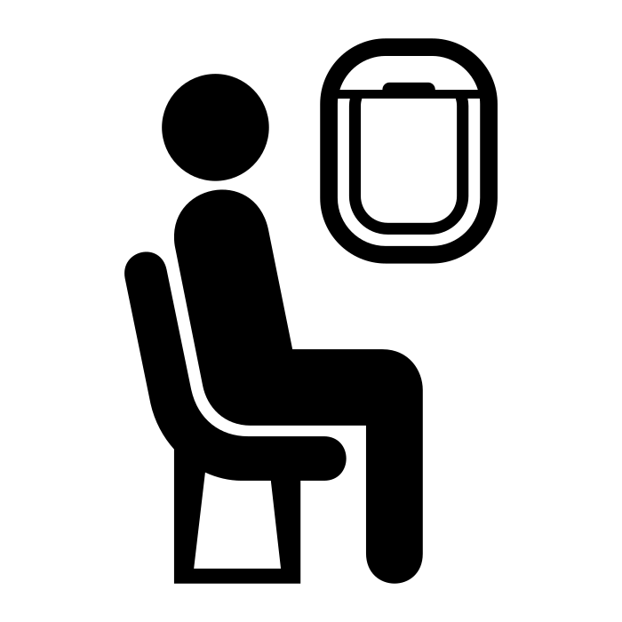
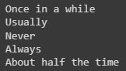
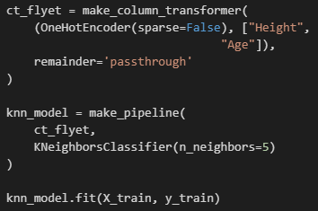
KNN Model: Flying Etiquette Data
Built a k-nearest neighbors model to predict if passengers ever recline their seat when they fly
Predictor variables:
Height (Quantitative)
Age (Categorical)
Ended up with an accuracy of 23%, yikes!

Slide 13
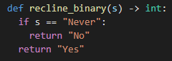
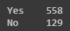
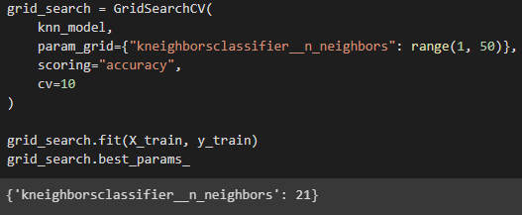
KNN Model: Flying Etiquette Data
Wrote a function to turn our response variable to a binary one
Optimized the number of neighbors using a grid search and ended up with k = 21
Accuracy is now 81%, yay!

Slide 14
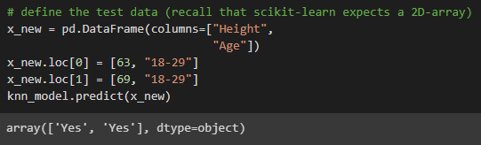
Testing out the model on ourselves
Defined a new dataframe to use the machine learning algorithm on ourselves
Lana - index 0
Rachel - index 1
Both predictions were accurate because we recline our seats on flights!! :)

Slide 15
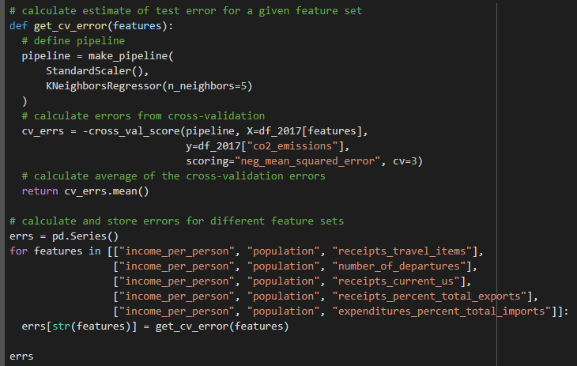
Ensemble Model: International Tourism
Tried to predict CO2 emission levels
Tested out a number of travel-related predictor variables

Slide 16
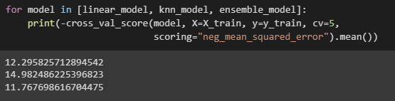
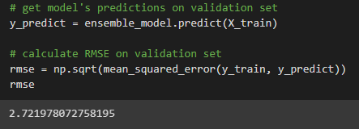
Ensemble Model: International Tourism
Ensemble model produced the lowest cross-validation score (still pretty high)
RMSE is fairly high, but this tells us valuable information that our model is not the best despite seemingly “linear trends” in the data exploration steps

Slide 17
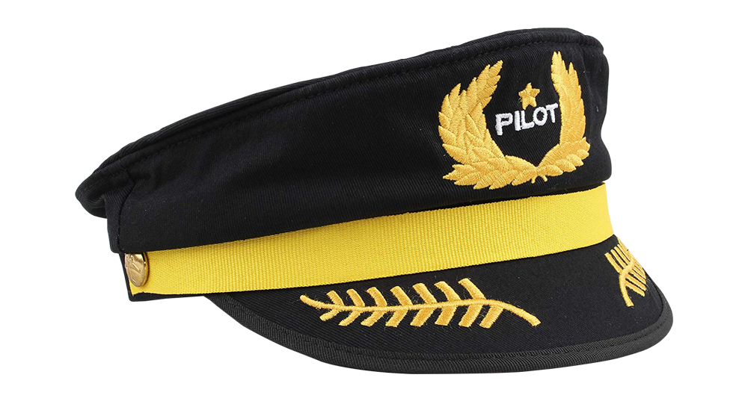
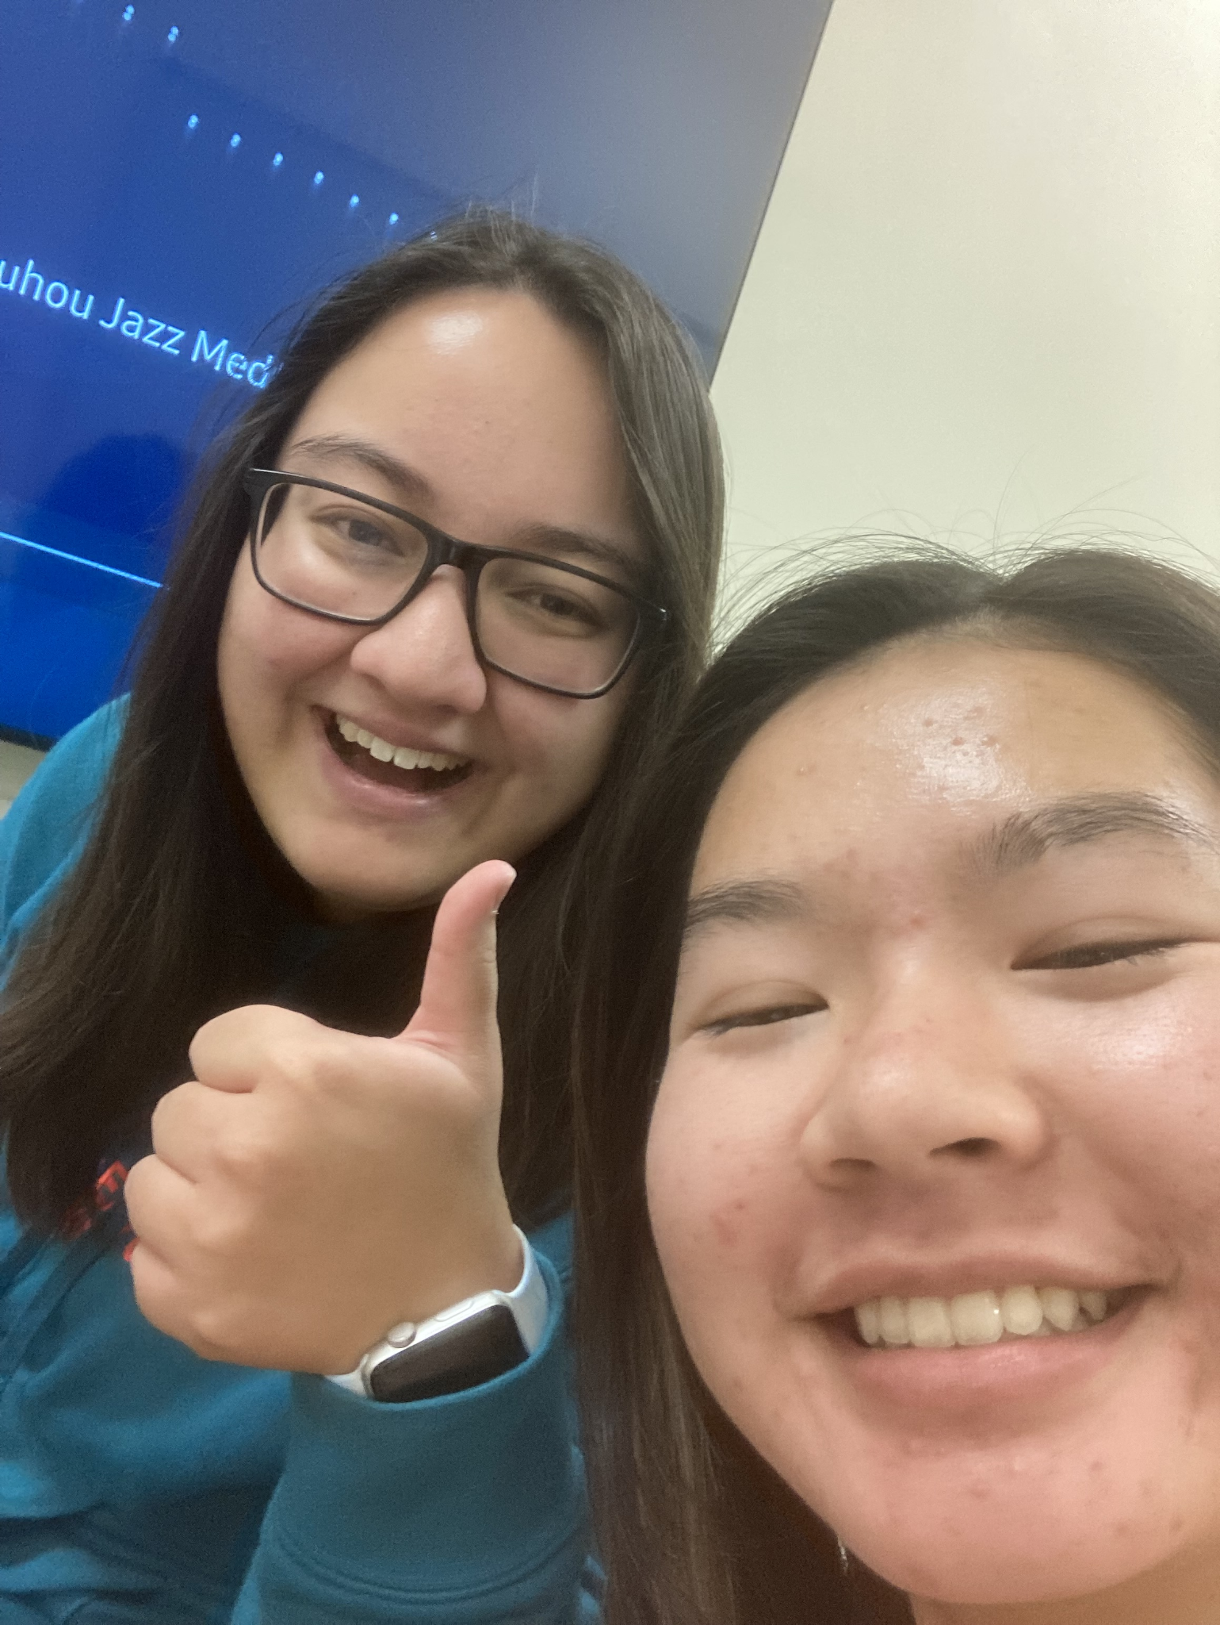
Thank you
Gracias
Merci
Danke
Xie xie
Cảm ơn
Arigato
Notes:
Thank you for choosing to fly with us today on Dynamic Duo Airlines. Local time is x and weather is y. We hope to see you again! Do you have any questions for your pilots?

